Slide 1
19Z510- COMPUTER NETWORKS LABORATORY

Slide 2
SCHEME OF WORK
1. Study of Network Components
2. Study of Basic Network Commands and Network Configuration Commands
3. The following experiments are to be implemented in - C language:
Simple Chat Program using TCP Sockets
ii. DNS using UDP Sockets
iii. Sliding Window Protocol using TCP Sockets
4. Study of Wireshark Tool
5. Tracing of TCP and UDP Connection using Wireshark

Slide 3
SCHEME OF WORK
6. Study of any Simulator Tool
7. Simulation of TCP Performance using Simulator Tool
8. Simulation of UDP Performance using Simulator Tool
9. Performance Comparison of Routing Protocols using Simulator Tool
10. Set up a typical network in a lab

Slide 4
GENERAL INSTRUCTIONS
Observation
Record
Right hand side
Aim
Algorithm
Result
Left hand side
Sample IO
Figures (if any)
For each exercise submit the printout of the programs and output screenshot, the fore-coming week.
Evaluation pattern is based on submission date & Viva (observation & record)

Slide 5
Experiment 1: Study of Network Components
COMPUTER NETWORK
A collection of computing devices that are connected in various ways in order to communicate and share resources. Cambridge Dictionary
Usually, the connections between computers in a network are made using physical wires or cables.
However, some connections are wireless, using radio waves or infrared signals.

Slide 6
COMPUTER NETWORK
A computer network is a telecommunications network that allows computers to exchange data.
The best-known computer network is the internet.
Computer network connects two or more autonomous computers.
The computers can be geographically located
anywhere.

Slide 7
Think and Answer
What kind of network is generally used in our college laboratories?
What kind of network do you use in your home or in day-to-day life?
----Justify your answers!

Slide 8
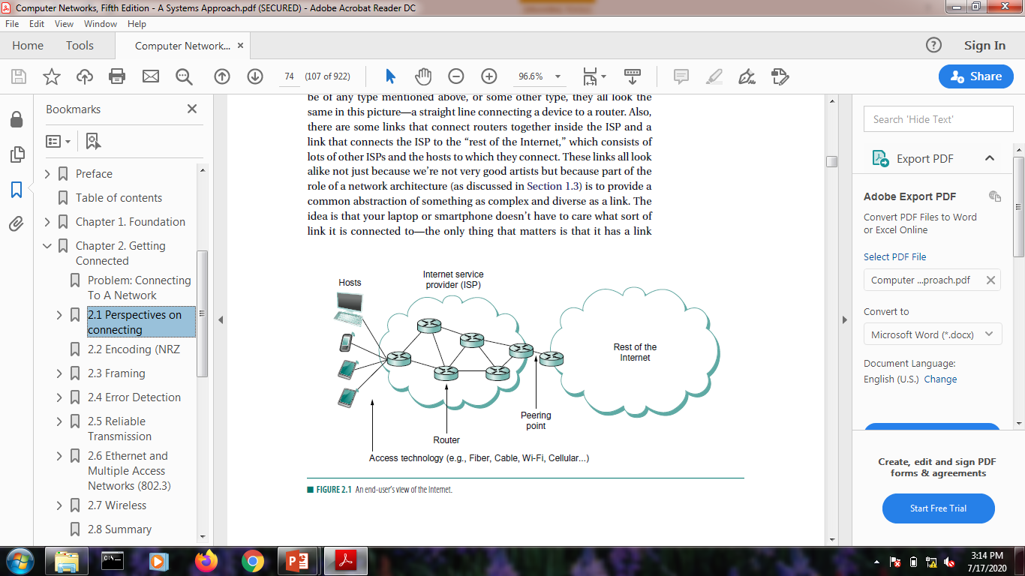
Building Blocks of Network
Nodes
Computers and other devices in a network
Links
Physical connection between the nodes by coaxial cables or optical fibers.

Slide 9
Think & Answer
What are the nodes that you find in our college laboratories?
How do you think the nodes are connected in our college laboratories?
----Justify your answers!

Slide 10
TYPES OF NETWORK
Based on the size and the coverage area, networks are categorized into the following types
Personal Area Networks (PANs)
Local Area Networks (LANs)
Metropolitan Area Networks (MANs)
Wide Area Networks (WANs)

Slide 11
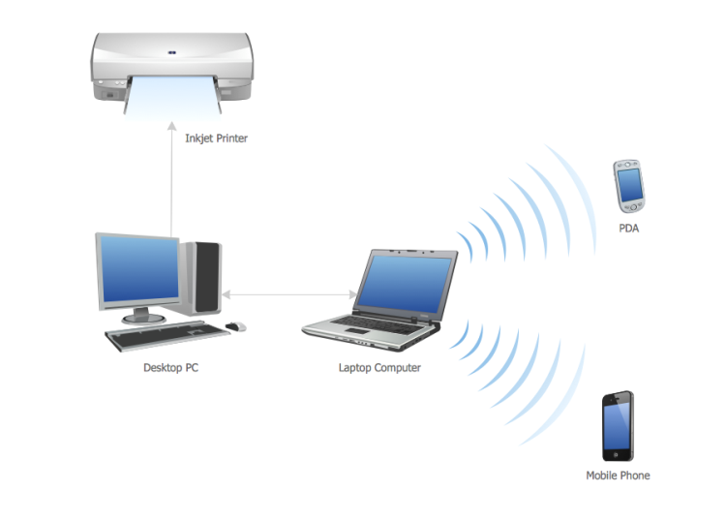
PERSONAL AREA NETWORKS (PANs)
A personal area network handles the interconnection of IT devices at the surrounding of a single user
Is a small network established for communication between different devices, such as laptops, computers, mobiles, and PDAs.
A PAN may include wired and wireless devices.
The reach of a PAN typically extends to 10 meters.

Slide 12
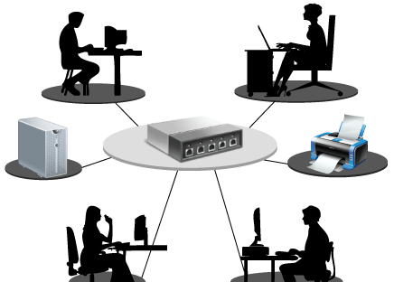
LOCAL AREA NETWORK (LANS)
A local area network (LAN) is a network that connects computers and devices in a limited geographical area such as a home, school, office building, or closely positioned group of buildings.
Wired LANs are most likely based on Ethernet
technology.
LANs are typically faster networks with
speeds of at least 10 Mbps to 10 Gbps.
A LAN network is limited to between
100-1000 meters coverage

Slide 13
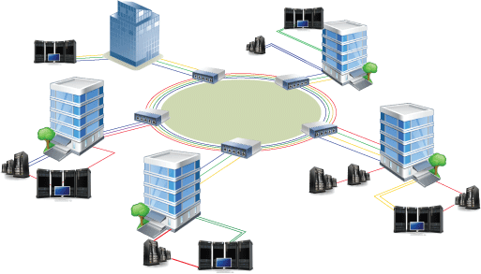
METROPOLITAN AREA NETWORK (MAN)
It is relatively larger than LAN and extends across a city or a metropolitan.
It is created by connecting two or more LANs located at different locations in a city.

Slide 14
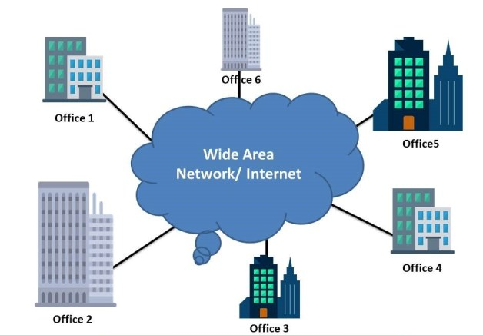
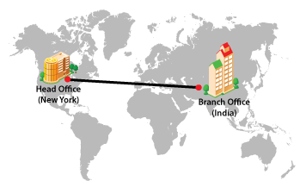
WIDE AREA NETWORK (WAN)
A wide area network (WAN) is a computer network that covers a large geographic area such as a city, country, or spans even intercontinental distances.
A WAN uses a communications channel that combines many types of media such as telephone lines, cables, and air waves.
A WAN often makes use of transmission facilities
provided by common carriers, such as telephone
companies.
Examples of the existing WAN is the Internet.

Slide 15
Think & Answer
What type of network exists in our laboratory?
Have you created a PAN network? If so. why? If not can you think of an occasion where you need to create a PAN network?
----Justify your answers!

Slide 16

CLASSIFICATION OF NETWORK ARCHITECTURE
The architecture of a network is a logical design that determines how the devices in the network communicate.
The commonly used architectures for computer networks are:
Client-server architecture
Peer-to-peer architecture
Hybrid architecture

Slide 17
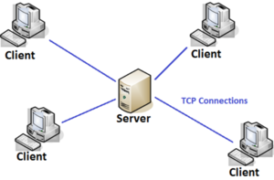
CLIENT-SERVER ARCHITECTURE
On a network built using the client-server architecture, the devices communicate to other devices through a central computer referred to as a server.
The server is a terminal with high processing power, which provides services for the other computers on the network.
The client is a terminal that accesses the resources available on a server.

Slide 18
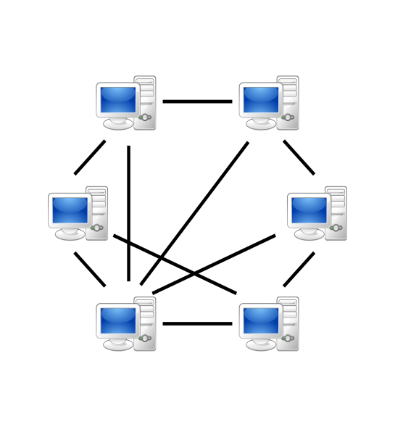
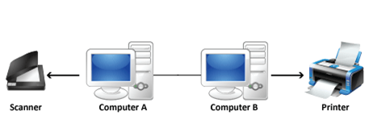
PEER-TO-PEER ARCHITECTURE
On a network built using the peer-to-peer architecture, no specific distinction exists between a client and a server.
Any node can provide a service as well as send a request for a service from another node on the network.
The peer-to-peer network architecture allows sharing of resources, data, and users.
Each node on the network has full control over the network resources.

Slide 19
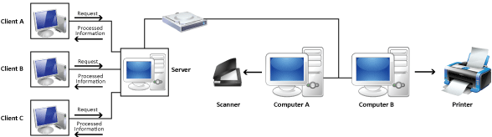
HYBRID ARCHITECTURE
A hybrid, in general, is a composition of two different types of elements.
A hybrid network architecture is created to get the benefits of both, the peer-to-peer and the client-server architectures, in a network.

Slide 20
Think & Answer
What kind of network Architecture is used in our Department laboratories?
----Justify your answers!

Slide 21
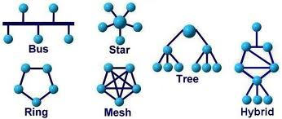
NETWORK TOPOLOGY
The pattern of interconnection of nodes in a network is called the Topology.
This layout also determines the manner in which information is exchanged within the network.
The different types of network topologies that can be used to set up a network are:
Bus Topology
Star Topology
Ring Topology
Mesh Topology
Tree Topology
Hybrid Topology

Slide 22
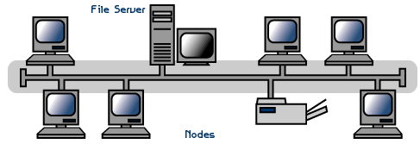
BUS TOPOLOGY
Popular topology for data network.
Single transmission medium on which various nodes are attached.
This type of structure permits any station on the network to talk to any other station,
Rules are required for when two stations attempt to communicate at the same time.
Break in the bus affects only network stations on one side of the break that wish to communicate with stations on the other side of the break.
If N is the number of nodes, then the number of links is N+1

Slide 23
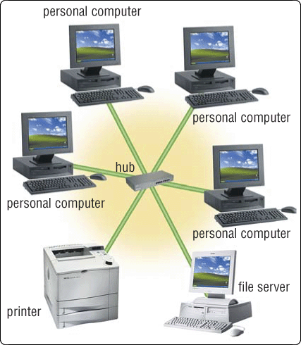
STAR TOPOLOGY
The star topology connects nodes over a network using a central control network controller.
You can easily add nodes to a star-based network by attaching the required nodes to the controller.
Each station on the network is connected to a network controller.
Then access from any one station on the network to any other station can be accomplished
only through the network controller.
Failure of the network controller
will affect the entire network
inoperative.
If N is the number of nodes, then the number of links is N

Slide 24
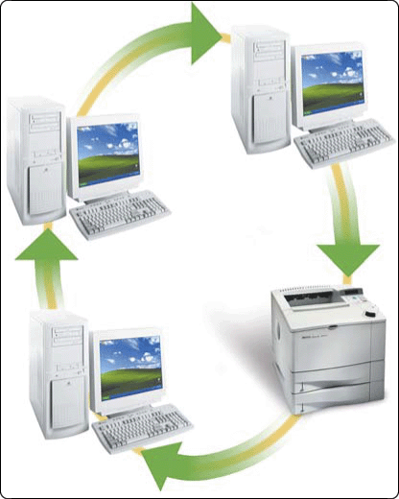
RING TOPOLOGY
The ring topology connects the nodes on a network through a point-to-point connection.
When a device sends data, it must travel through each device on the ring until it reaches its destination
A ring topology can thus be considered to be a looped bus.
If one of the nodes on the network stops, the entire network stops functioning.
If N is the number of nodes, then the number of links is N

Slide 25
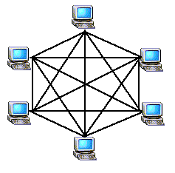
MESH TOPOLOGY
The mesh network topology employs either of two schemes, called
Full mesh topology: each workstation is connected directly to each of the others.
Partial mesh topology, some workstations are connected to all the others, and some are connected only to those other nodes with which they exchange the most data.
This provide an alternate route mechanism.
Excellent for long distance networking.
Supports back-up and rerouting.
The number of connections grows
with the number of nodes.
If N is the number of nodes, then the number of links is N(N-1)/2

Slide 26
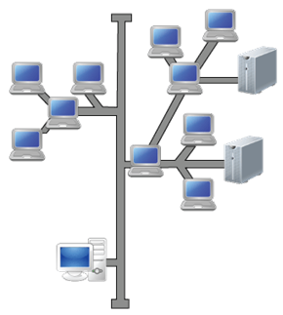
TREE TOPOLOGY
The tree topology is created where the nodes are connected in a hierarchical manner.
In tree topology, the device at the root is referred to as the parent for all the other nodes or devices in the network.
The nodes below a parent node are referred
to as child nodes.

Slide 27
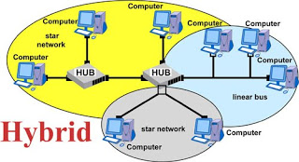
HYBRID TOPOLOGY
The hybrid topology can be a combination of two or more basic topologies, such as bus, ring, star, mesh, or tree.
Hybrid networks combine more than two topologies, which, in turn, enable you to get advantages of the constituent topologies.

Slide 28
Think &Answer
What kind of topology used in our dept. laboratories?
Why?

Slide 29
Networking Components The following are some of the computer components in a computer network.
Node
Host
Client/Server
Network Transmission Medium
Ports
Network Interface-NIC
Access Point
Repeater
Hub
Switch
Bridge
Router
Gateway
Modem

Slide 30
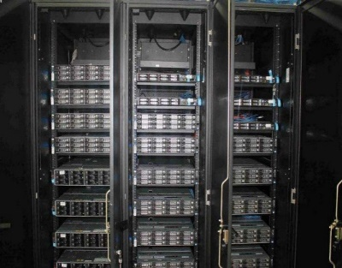
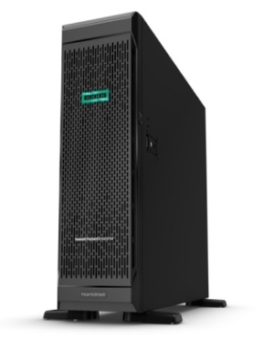
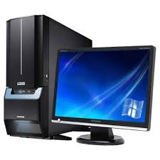
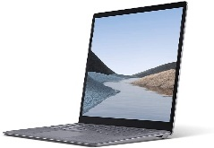

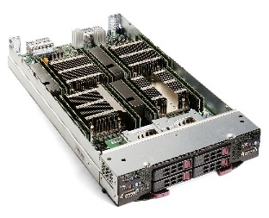
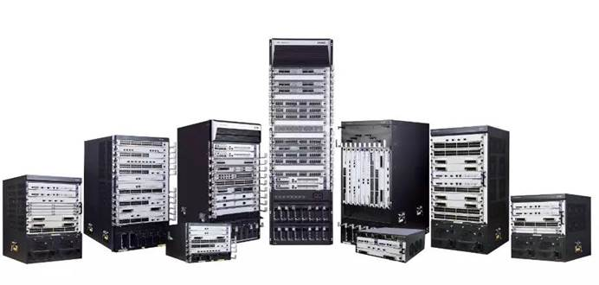
Node
Any entity connected to a network and capable of both creating and using network data.
Example:
A printer with a network interface is called as node

Slide 31
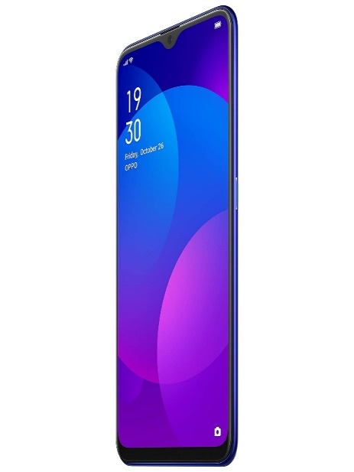


Host
Any node that supports users and runs application software.
Host and node are often used interchangeably.
Host is any node that supports one or more users and runs network application software.

Slide 32
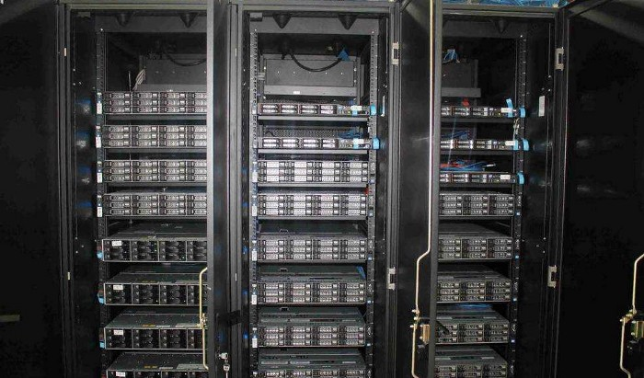

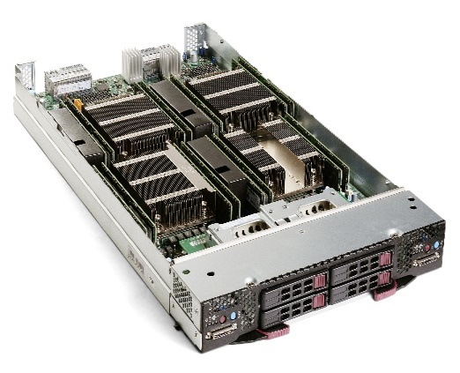

Client & Server
Client
A network entity that requests some network service from a server.
Server
A network entity that fulfills requests from clients.

Slide 33
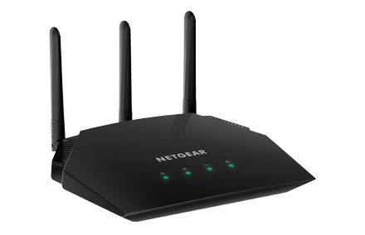
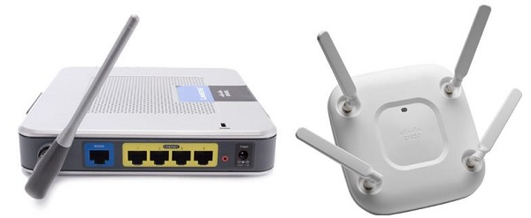
Access Point
Used to interconnect wireless devices and provide a connection to the wired LAN.
The data transfer speeds for access points is dictated by the choice of wireless technology for the clients.

Slide 34
BASIC HARDWARE COMPONENTS
All networks are made up of basic hardware building blocks to interconnect network nodes, such as Network Interface Cards (NICs), Bridges, Hubs, Switches, and Routers.
Components required for interconnecting the network nodes:
NETWORK INTERFACE CARD
REPEATERS
NETWORK HUB
NETWORK BRIDGE
NETWORK SWITCH
ROUTER
GATEWAY
MODEM

Slide 35
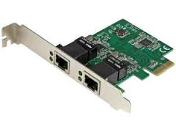
NETWORK INTERFACE CARD
A network card, network adapter or NIC is a piece of computer hardware designed to allow computers to communicate over a computer network.
It provides physical access to a networking medium and often provides a low-level addressing system through the use of MAC (Media Access Control) addresses.
Network Interfaces convert a node’s data into electronic signals for transmission over a metal wire or into signals appropriate for optical cable for wireless radio transmission or for any other mode of communication.

Slide 36
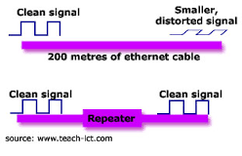
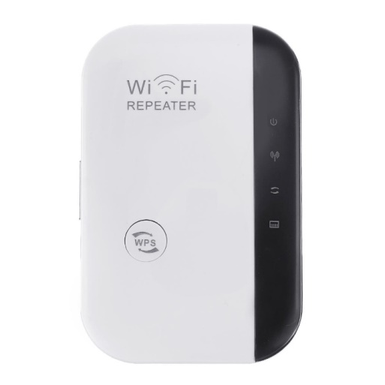
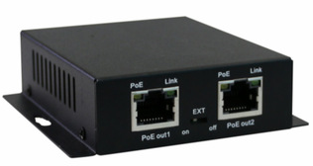
REPEATER
A repeater is an electronic device that receives a signal and retransmits it at a higher power level to the other side of an obstruction, so that the signal can cover longer distances without degradation.
It is also called data regenerator.
In most twisted pair Ethernet configurations, repeaters are required for cable runs longer than 100 meters.

Slide 37
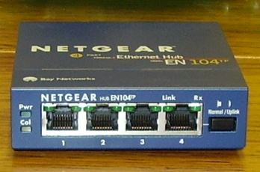
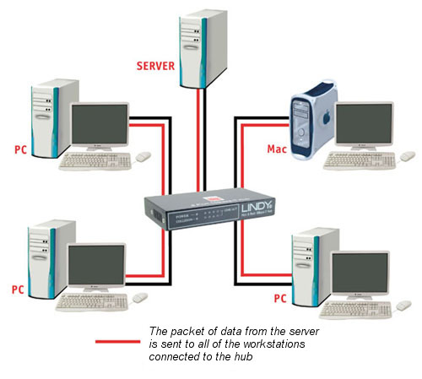
Hub
A Hub is the simplest of the networking devices.
A hub takes an input (frame’s bits) and retransmits the input on the hub’s outgoing ports.
It basically broadcasts (transmission to all connected devices) the data it receives to all devices connected to its ports.
This leads to inefficiencies and wastage.
Hubs are used on small networks where data transmission is not very high.

Slide 38
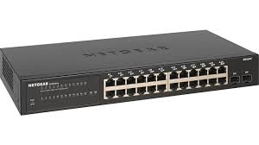
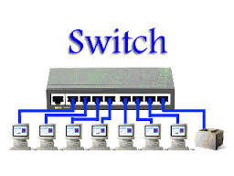
Switch
Forwards a frame (sequence of bits) it received directly out of the port associated with the destination address.
It can be used to reduce unnecessary traffic and isolate sections of networks.
A switch stores hardware physical address for each device connected to its ports.
Switch directly connect two communicating devices.

Slide 39
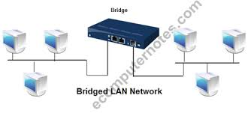
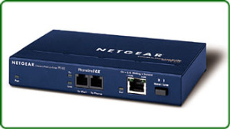
NETWORK BRIDGE
A bridge is a networking device that uses the MAC address to forward data and it interconnects two LANs.
Once the bridge associates a port and an address, it will send traffic for that address only to that port.
Bridges do send broadcasts to all ports except the one on which the broadcast was received.
Networks running the same type of protocol(eg.Ethernet) is called a transparent bridge.
The bridge that interconnects two LANs operating two different protocols (eg.Ethernet, token ring) is called a translation bridge.
The use of wireless bridges in LANs is a popular choice for interconnecting the LANs due to its less cost.

Slide 40
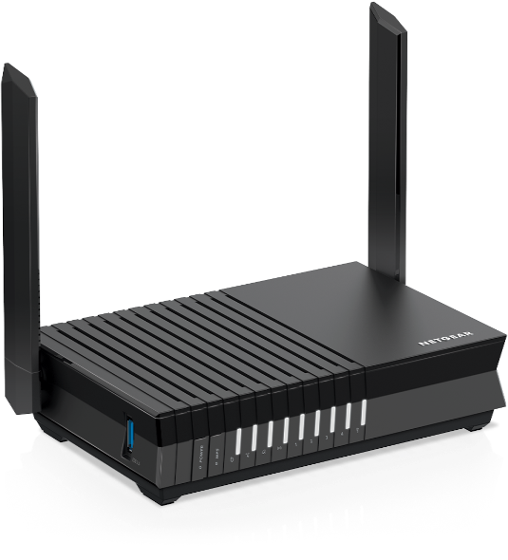
Router
A router is a system that applies intelligence to the movement of network data.
Usually, routers use the IP address to forward packets, which allows the network to go across different protocols.
The most common home use for routers is to share a broadband internet connection.
As the router has a public IP address which is shared with the network, when data comes through the router, it is forwarded to the correct computer.

Slide 41
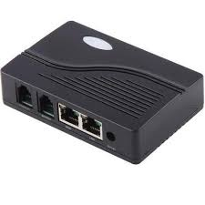

Gateway
It is used to describe the networking device that enables hosts in a LAN to connect to network and hosts outside the LAN.
It provides a variety of translating or conversion functions.

Slide 42
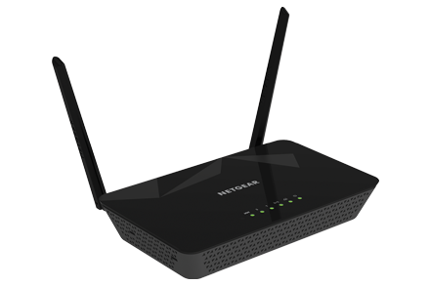
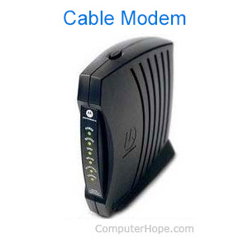
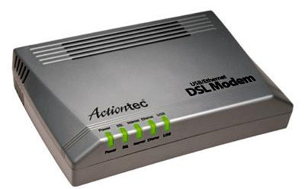
Modem
Modem is a contraction of the compound term modulator-demodulator.
It is an electronic device used to convert digital signals generated by computers and terminal devices into analog signals for transmission over telephone network.
At the receiving end, a similar device accepts the transmitted signals, reconverts them to digital signals and delivers them to the connected device.

Slide 43
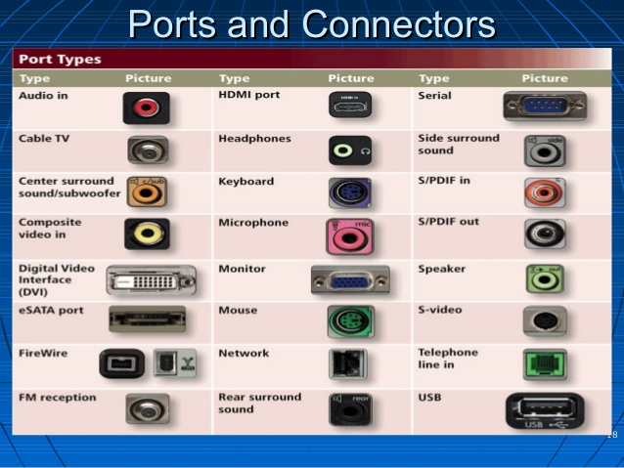
Port
The physical input/output interfaces on a networking device/hardware.

Slide 44
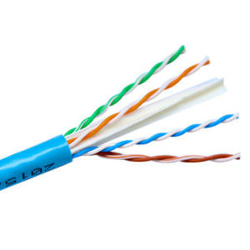
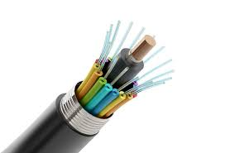
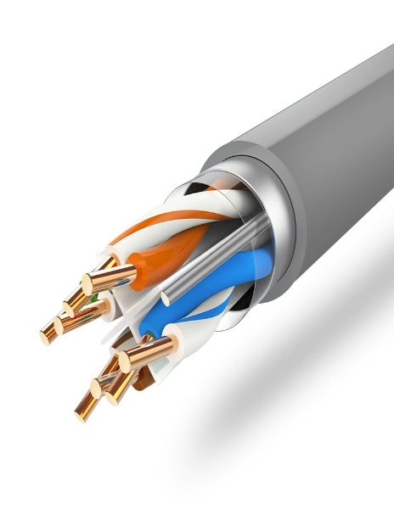
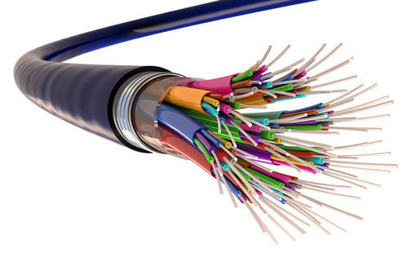
Network Transmission Medium
The physical thing(s) over or through which network signals are carried.
The term link is often used to refer to the shared medium and the set of rules governing transmissions on that medium.

Slide 45
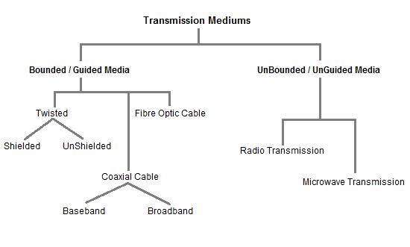
TRANSMISSION MEDIUM

Slide 46
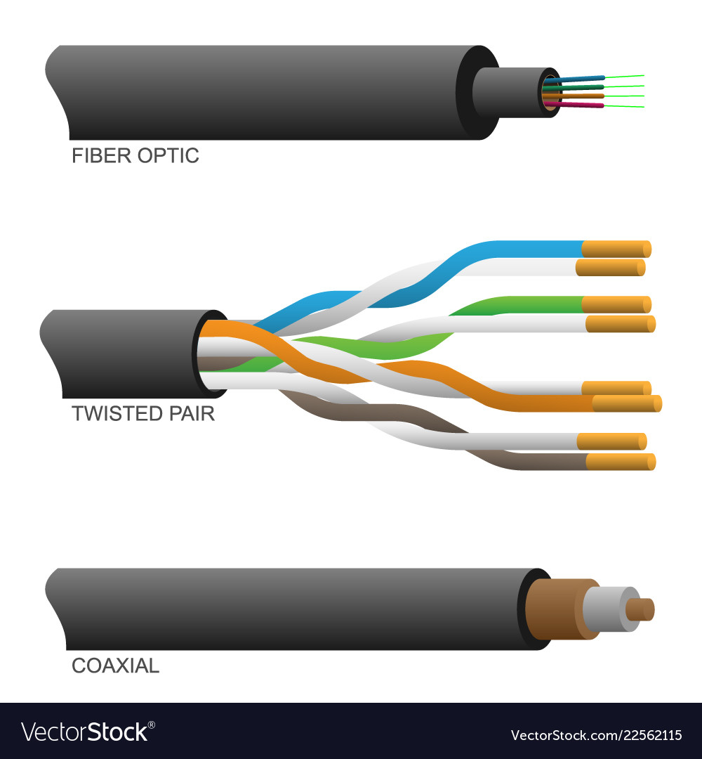
Wired Transmission Media
Guided media, are those that provide a conduit from one device to another.
Eg: twisted-pair cable, coaxial cable, and fiber-optic cable.
A signal traveling along any of these media is directed and contained by the physical limits of the medium.
Twisted-pair and coaxial cable use metallic (copper) conductors that accept and transport signals in the form of electric current.
Optical fiber is a cable that accepts and transports signals in the form of light.

Slide 47
Twisted Pair Cable
A twisted pair consists of two conductors (normally copper), each with its own plastic insulation, twisted together.
One of the wires is used to carry signals to the receiver, and the other is used only as a ground reference.
Most commonly used and is cheaper than others.
lightweight, can be installed easily.
Twisted Pair is of two types:
Unshielded Twisted Pair (UTP)
Shielded Twisted Pair (STP)

Slide 48

STP Vs UTP
STP cable has a metal foil or braided mesh-covering that encases each pair of insulated conductors.
UTP does not.
metal casing improves the quality of cable by preventing the penetration of noise or crosstalk, but it is bulkier and more expensive

Slide 49

Twisted Pair Connector
The most common UTP connector is RJ45 (RJ stands for registered jack
The RJ45 is a keyed connector, meaning the connector can be inserted in only one way.

Slide 50
Twisted Pair
Applications
Twisted-pair cables are used in telephone lines to provide voice and data channels.
The local loop-the line that connects subscribers to the central telephone office-commonly consists of unshielded twisted-pair cables.
The DSL lines that are used by the telephone companies to provide high-data-rate connections also use the high-bandwidth capability of unshielded twisted-pair cables.
Local-area networks, such as l0Base-T and l00Base-T, also use twisted-pair cables.

Slide 51

Coaxial Cable
Coaxial cable (or coax) carries signals of higher frequency ranges than those in twisted-pair cable.
coax has a central core conductor of solid or stranded wire (usually copper) enclosed in an insulating sheath, which is, in turn, encased in an outer conductor of metal foil, braid, or a combination of the two.
The outer metallic wrapping serves both as a shield against noise.
This outer conductor is also enclosed in an insulating sheath, and the whole cable is protected by a plastic cover
Types
Baseband
Broadband

Slide 52

Baseband Vs Broadband
Baseband
This is a 50 ohm (Ω) coaxial cable which is used for digital transmission.
It is mostly used for LAN’s. Baseband transmits a single signal at a time with very high speed.
Broadband
This uses analog transmission on standard cable television cabling. It transmits several simultaneous signal using different frequencies.
It covers large area when compared with baseband coaxial cable.

Slide 53



Coaxial Cable Connector
The most common type of connector used today is the Bayone-Neill-Concelman (BNC), connector.
Three popular types of connectors:
BNC connector,
BNC T connector,
BNC terminator.
The BNC connector is used to connect the end of the cable to a device, such as a TV set.
The BNC T connector is used in Ethernet networks to branch out to a connection to a computer or other device.
The BNC terminator is used at the end of the cable to prevent the reflection of the signal.

Slide 54
Coaxial Cable
Applications
In the traditional cable TV network, the entire network used coaxial cable.
hybrid networks use coaxial cable only at the network boundaries, near the consumer premises.
Another common application of coaxial cable is in traditional Ethernet LANs. Because of its high bandwidth, and consequently high data rate, coaxial cable was chosen for digital transmission in early Ethernet LANs.
The 10Base-2, or Thin Ethernet, uses RG-58 coaxial cable with BNC connectors to transmit data at 10 Mbps with a range of 185 m.
The 10Base5, or Thick Ethernet, uses RG-11 (thick coaxial cable) to transmit 10 Mbps with a range of 500 m. Thick Ethernet has specialized connectors

Slide 55

Fiber-Optic Cable
A fiber-optic cable is made of glass or plastic and transmits signals in the form of light.
Optical fibers use reflection to guide light through a channel.
A glass or plastic core is surrounded by a cladding of less dense glass or plastic.
The difference in density of the two materials must be such that a beam of light moving through the core is reflected off the cladding instead of being refracted into it.

Slide 56

Fiber-Optic Cable Connector
Common three types:
The subscriber channel (SC) connector is used for cable TV. It uses a push/pull locking system.
The straight-tip (ST) connector is used for connecting cable to networking devices. It uses a bayonet locking system and is more reliable than SC.
MT-RJ is a connector that is the same size as RJ45.

Slide 57
Fiber-Optic Cable
Applications
Fiber-optic cable is often found in backbone networks because its wide bandwidth is cost-effective
Some cable TV companies use a combination of optical fiber and coaxial cable, thus creating a hybrid network. Optical fiber provides the backbone structure while coaxial cable provides the connection to the user premises.
This is a cost-effective configuration since the narrow bandwidth requirement at the user end does not justify the use of optical fiber.
Local-area networks such as 100Base-FX network (Fast Ethernet) and 1000Base-X also use fiber-optic cable.

Slide 58
Radio Waves Waves of frequency range 3 KHz - 1 GHz Omni-directional, these waves can move in all directions Radio waves of frequency 300KHz-30MHz can travel long distance Susceptible to interference Radio waves of frequency 3-300KHz can penetrate walls These waves are used in AM and FM radio, television, cordless phones.
Micro waves Electromagnetic waves of frequency range 1GHz - 300GHz. Unidirectional, can move in only one direction. Cannot penetrate solid objects such as walls, hills or mountains. Needs line-of-sight propagation i.e. both communicating antenna must be in the direction of each other. Used in point-to-point communication or unicast communication such as radar and satellite. 6. Provide very large information-carrying capacity
Infrared waves Electromagnetic waves of frequency range 300GHz - 400THz. Very high frequency waves. Cannot penetrate solid objects such as walls. 4. Used for short-distance point-to-point communication such as mobileto-mobile, mobile-to-printer, remote-control-to-TV, and Bluetoothenabled devices to other devices like mouse, keyboards etc.

Slide 59


Wireless Transmission Media
Unguided media transport electromagnetic waves without using a physical conductor.
Signals are normally broadcast through free space and thus are available to anyone who has a device capable of receiving them.
Unguided signals can travel from the source to destination in several ways:
Ground propagation,
sky propagation,
line-of-sight propagation,

Slide 60

Wireless Transmission Media
In ground propagation, radio waves travel through the lowest portion of the atmosphere, hugging the earth.
In sky propagation, higher-frequency radio waves radiate upward into the ionosphere (the layer of atmosphere where particles exist as ions) where they are reflected back to earth.
In line-or-sight propagation, very high-frequency signals are transmitted in straight lines directly from antenna to antenna

Slide 61

Radio Waves
Electromagnetic waves ranging in frequencies between 3 kHz and 1 GHz are normally called radio waves.
Radio waves, particularly those waves that propagate in the sky mode
radio waves a good candidate for long-distance broadcasting.
Radio waves use omnidirectional antennas that send out signals in all directions.
Applications:
multicasting-in which there is one sender but many receivers.
AM and FM radio, television, cordless phones, and paging

Slide 62

Microwaves
Electromagnetic waves having frequencies between 1 and 300 GHz are called microwaves.
Microwaves are unidirectional.
Microwave propagation is line-of-sight.
Applications:
Unicast - one-to-one communication is needed between the sender and the receiver.
cellular phones, satellite networks and wireless LANs

Slide 63

Infrared
Infrared waves, with frequencies from 300 GHz to 400 THz (wavelengths from 1 mm to 770 nm).
used for short-range communication.
line-of-sight propagation.
Applications:
used to transmit digital data with a very high data rate.

Slide 64


